Slide 1
Hybrid System:
- Evolutionary Neural Networks
- Neural Expert System
By Greg

Slide 2
Evolutionary Neural Networks
Neural networks are used for solving a variety of problems,
But they still have some limitations:
  Neural network training cannot guarantee an optimal solution.
    Eg. the back-propagation algorithm might converge to a set of sub-optimal weights.
  Designing a neural network topology is still more art than engineering.
Genetic algorithms are an effective optimisation technique that can guide both weight optimisation and topology selection.
JST - Evo NN & Neural Expert System

Slide 3
Evolutionary Neural Networks
Often the architecture of the network (i.e. the number of neurons and their interconnections) determines the success or failure of the application.
Usually the network architecture is decided by trial and error.
  We need to design automatically the architecture.
We can use The Genetic Algorithms to select the network architecture automatically.
The basic idea:
  Conduct a genetic search in a population of possible architectures.
JST - Evo NN & Neural Expert System

Slide 4
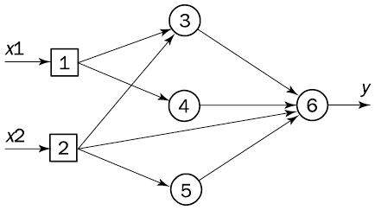
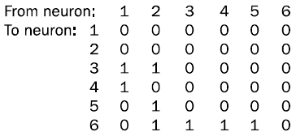
Encode The Networks Structure
Simple Example: Direct Encoding
Multilayer feedforward neural network
Array of Connection
Chromosomme:
JST - Evo NN & Neural Expert System

Slide 5
Training Algorithm
Given a set of training examples and a binary string representation, GA Training Algorithm can be described by the following steps:
Step 1: Choose the size of a population, the crossover and mutation probabilities, and define the number of training epochs.
Step 2: Define a fitness function to measure the performance, or fitness of an individual chromosome.
(In general, the network’s fitness should be based not only on its accuracy, but also on its learning speed, size and complexity. However, the network’s performance is much more important than its size, and therefore the fitness function can still be defined by the Sum of Squared Errors)
Step 3: Randomly generate an initial population of chromosomes.
JST - Evo NN & Neural Expert System

Slide 6
Training Algorithm
Step 4: Decode an individual chromosome into a Neural Network.
(Since the networks are restricted to be feedforward, ignore all feedback connections. Set initial weights of the network to small random numbers (-1, 1). Train the network on a training set of examples for a certain number of epochs using The Backpropagation Algorithm. Calculate The Sum of Squared Errors and determine the network’s fitness )
Step 5: Repeat Step 4 until all the individuals in the population have been considered.
Step 6: Select a pair of chromosomes for mating, with a probability proportionate to their fitness.
Step 7: Create a pair of offspring chromosomes by applying the genetic operators crossover and mutation.
(A crossover operator randomly chooses a row index and simply swaps the corresponding rows between two parents, creating two offspring. A mutation operator flips one or two bits in the chromosome with some low probability, say 0.005)
JST - Evo NN & Neural Expert System

Slide 7
Training Algorithm
Step 8: Place the created offspring chromosomes in the new population.
Step 9: Repeat Step 6 until the size of the new chromosome population becomes equal to the size of the initial population, and then replace the initial (parent) chromosome population with the new (offspring) population.
Step 10: Go to Step 4, and repeat the process until a specified number of generations has been considered.
JST - Evo NN & Neural Expert System

Slide 8
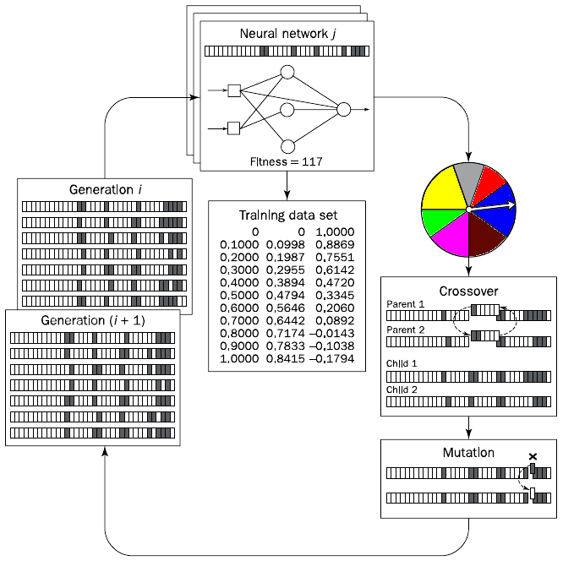
The evolutionary cycle of evolving a neural network topology

Slide 9
Neural Expert System (Introduction)
Expert systems and neural networks share common goals.
  Imitate human intelligence to create an intelligent machine.
But they use very different approachs to achieve the goals.
Expert Systems:
  rely on logical inferences and decision trees.
  focus on modelling human reasoning.
Neural Networks:
  rely on parallel data processing.
  focus on modelling a human brain.
JST - Evo NN & Neural Expert System

Slide 10
Ruled Based vs Neural Network
Knowledge in a rule-based expert system:
  Represented by IF-THEN production rules.
  Collected by observing or interviewing human experts (knowledge acquisition).
  Difficult and expensive.
  Once the rules are stored, they cannot be modified by the expert system itself.
  Cannot learn from experience or adapt to new environments.
  Only a human can manually modify the knowledge base by adding,changing or deleting some rules.
  knowledge can be divided into individual rules
    the user can see and understand the piece of knowledge applied by the system.
Knowledge in neural networks:
  Stored as synaptic weights between neurons.
  Obtained during the learning phase when a training set of sample data is presented to the network.
  Learn without human intervention.
  Uncertainty & imprecision tolerance
  knowledge is embedded in the entire network (the synaptic weight)
    it cannot be broken into individual pieces
    any change of a synaptic weight can lead to unpredictable results.
JST - Evo NN & Neural Expert System

Slide 11
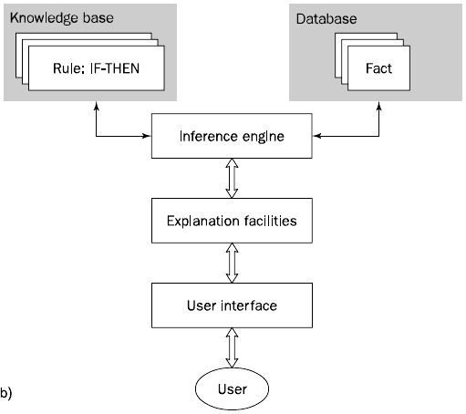
Ruled Based vs Neural Expert System
Rule Based Expert System
JST - Evo NN & Neural Expert System

Slide 12
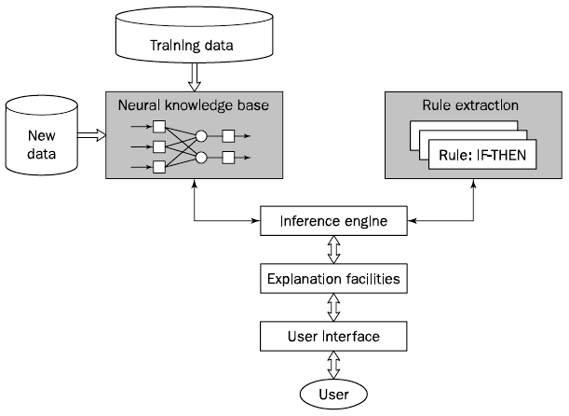
Neural Expert System
Extract
Neural Expert System
JST - Evo NN & Neural Expert System

Slide 13


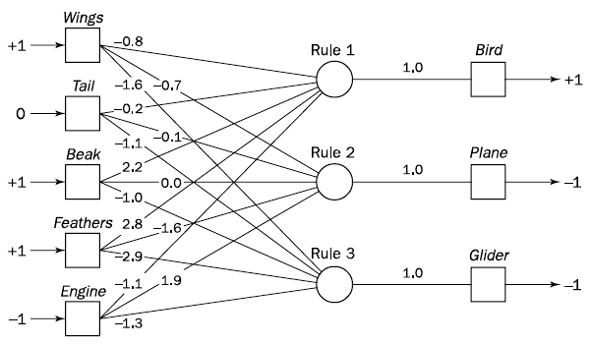
Neural Expert System (Example)
Input Layer
Conjunction Layer
Disjunction Layer
JST - Evo NN & Neural Expert System

Slide 14
Neural Expert System (Example)
Attach a corresponding question to each input neuron:
Neuron: Wings Question: Does the object have wings?
Neuron: Tail Question: Does the object have a tail?
Neuron: Beak Question: Does the object have a beak?
Neuron: Feathers Question: Does the object have feathers?
Neuron: Engine Question: Does the object have an engine?
JST - Evo NN & Neural Expert System

Slide 15
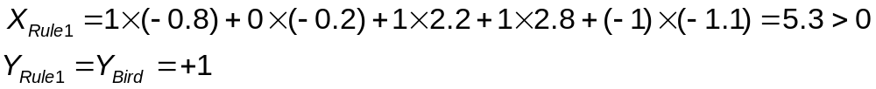
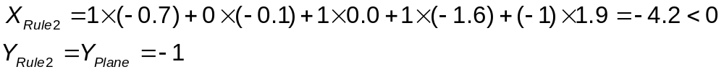
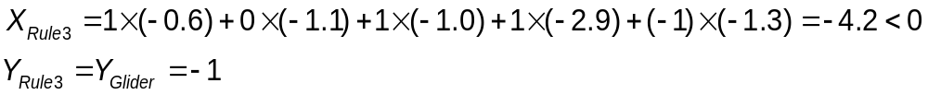
Neural Expert System (Example)
Example: If an unknown flying object has Wings, Beak and Feathers, but does not have Engine
Wings = True ⇒ 1; Tail = Unknown ⇒ 0; Beak ⇒ 1;
Feathers ⇒ 1; Engine = False ⇒ -1
The unknown flying object = Bird
JST - Evo NN & Neural Expert System

Slide 16
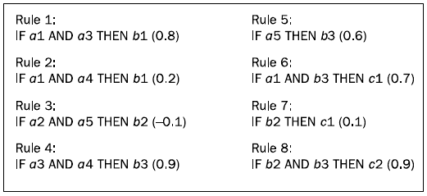
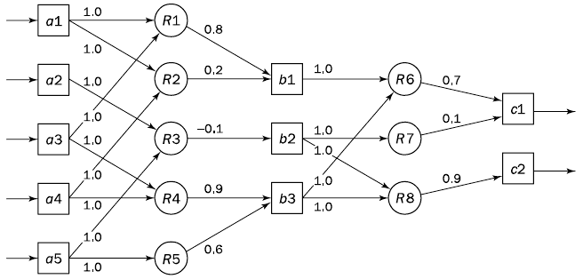
Neural Expert System (How to Train?)
1. Set Initial Structure & Initial weight
Domain Knowledge
b1
Disjunction Layer
Disjunction Layer
Conjunction Layer
Input Layer
Conjunction Layer
Train the network according to a given set of training data using an appropriate training algorithm (e.g. backpropagation).
When the training phase is completed, examine the neural network knowledge base, extract it and, if necessary, refine the IF-THEN rules.

Slide 17
Extracting Rule from Neural Network (Example)
Input Layer
Conjunction Layer
Disjunction Layer
JST - Evo NN & Neural Expert System

Slide 18
Extracting Rule from Neural Network
Use a simple algorithm concerned only with neurons directly connected to the neuron in question (Gallant, 1988).
  An input i is considered to be contributing if it does not move the net weighted input in the opposite direction.
First, we determine all contributing inputs and the size (weight) of each contribution (Gallant, 1993)
  Arrange them according to their sizes in a descending order.
Example: The inference that Bird is true
Bird attributes: Wings = True ⇒ 1; Tail = Unknown ⇒ 0; Beak ⇒ 1; Feathers ⇒ 1; Engine = False ⇒ -1
JST - Evo NN & Neural Expert System

Slide 19
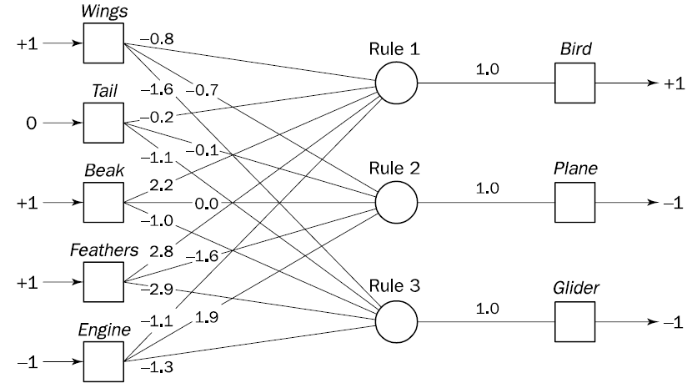
Extracting Rule from Neural Network
Input: Feathers Size: 2.8
Input: Beak Size: 2.2
Input: Engine Size: 1.1
Input: Tail Size: 0.2
JST - Evo NN & Neural Expert System

Slide 20
Extracting Rule from Neural Network
Create a rule in which the condition part is represented by the contributing input with the largest contribution:
IF Feathers is true
THEN Bird is true
Verify the rule:
KNOWN = 1 x 2.8 = 2.8
UNKNOWN = |-0.8| + |-0.2| + |2.2| + |-1.1| = 4.3
KNOWN < UNKNOWN
The rule is not valid, we need to add the ‘second best’ contributing input
IF Feathers is true
AND Beak is true
THEN Bird is true
JST - Evo NN & Neural Expert System

Slide 21
Extracting Rule from Neural Network
IF Feathers is true
AND Beak is true
THEN Bird is true
Verify the rule:
KNOWN = 1 x 2.8 + 1 x 2.2 = 5.0
UNKNOWN = |-0.8| + |-0.2| + |-1.1| = 2.1
KNOWN > UNKNOWN
The rule has passed the validity test (R1.1).
Similarly, we can obtain rules to justify that Plane is false (R1.2) and Glider is false (R1.3):
IF Engine is false
AND Feathers is true
THEN Plane is false
IF Feathers is true
AND Wings is true
THEN Glider is false
JST - Evo NN & Neural Expert System

